Slide 1
BIP Copilot
Empowering R&D teams with AI-driven natural language access
to clinical biomarker analysis and insights
ellmer + Tool Use
Clinical Visualizations
AI Report Generation
Claude Code Dev
Kaiping Yang
BeOne, Wuhan

Slide 2
disclaimer
The content, ideas, and conclusions presented herein are solely those of the authors and do not necessarily represent the views, policies, or official positions of BeOne Medicines. Although every effort has been made to ensure accuracy, BeOne Medicines assumes no responsibility for any statements, interpretations, or recommendations contained in this presentation.
All data presented are simulated (dummy data) for demonstration purposes only and do not represent actual or real-world data.
This material is intended for informational purposes only and should not be construed as official guidance from BeOne Medicines.

Slide 3
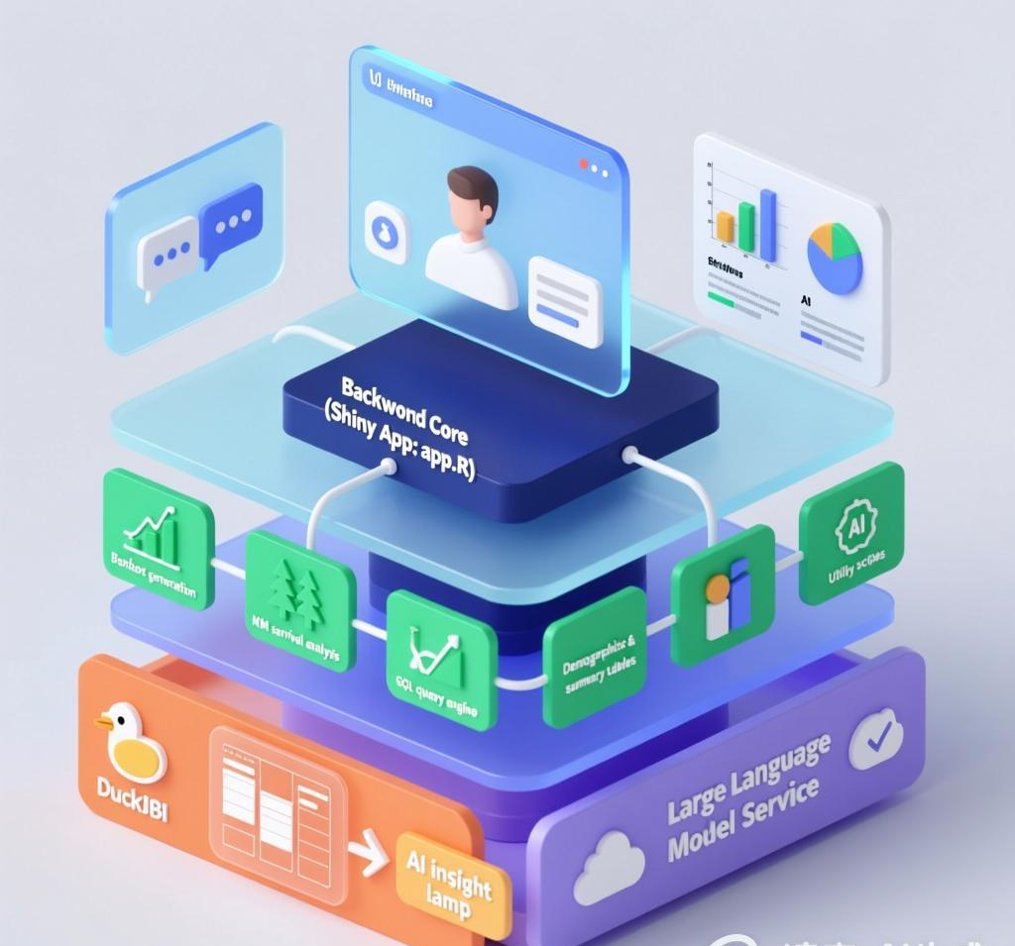
AI-Powered Clinical Biomarker Analysis Platform
Natural Language · Real-time Visualization · Automated Reports

Slide 4
EVOLUTION
How we serve R&D — the journey
As data & programming professionals, the question is: how do we build better products to support clinical R&D?
PHASE 1 · Study-by-Study Analysis
PHASE 2 · BIP Shiny App
PHASE 3 · BIP Copilot
CSR-style biomarker analysis
Each study analyzed separately
Custom R scripts per request
Results delivered as static reports
Pain: repetitive work across
hundreds of similar analyses
Standardized dropdown interface
Pre-computed results displayed
Consistent analysis across studies
Dropdown selectors for parameters
Advance: scalable, reproducible,
but fixed interaction patterns
AI-powered natural language
Flexible queries beyond dropdowns
Cross-study search & comparison
On-demand visualization + report
Unlock: new capabilities that
were never possible before
→
→

Slide 5
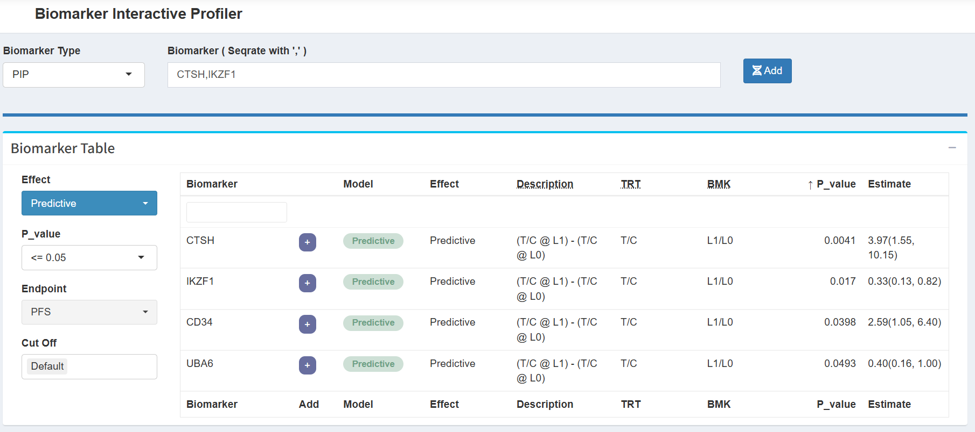
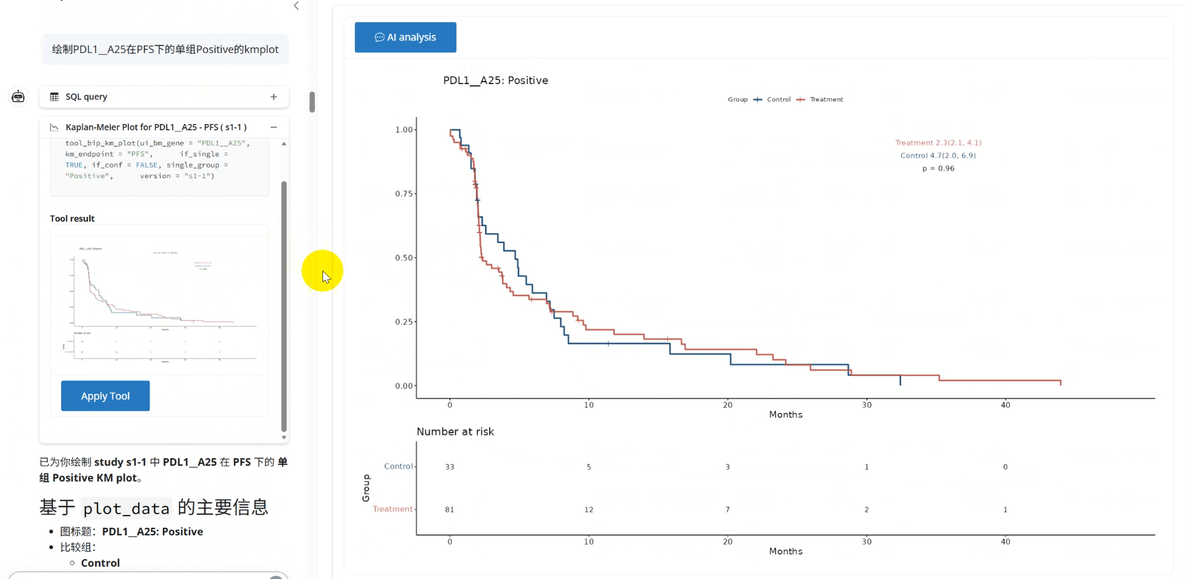
PARADIGM SHIFT
BIP → BIP Copilot: clicks to conversation
The same biomarker analysis — two fundamentally different user experiences
Before: BIP Shiny App
After: BIP Copilot
Dropdown selectors · Fixed interaction · Manual selection
Natural language · Flexible queries · AI visualization
→
User Select
Click → Filter → Click → View
AI Select
Ask → AI understands → Result
65% fewer interaction steps · Cross-study comparison · New capabilities unlocked

Slide 6
VISION
Three dimensions of better R&D support
01 · Quality at Different Speeds
02 · Experience-Guided Discovery
03 · AI-Accelerated Iteration
Pre-computed analysis
Validated results stored in DuckDB
Reproducible, auditable outputs
Real-time exploration
On-the-fly queries via SQL tool
Instant KM/forest/box plots
In the AI era, both matter
Domain knowledge encoded in:
System prompts — analysis norms
RAG context — CDISC standards
Built-in tool functions — validated
statistical methods (survminer, etc.)
The AI doesn't just execute —
it guides toward best practice
Claude Code for development
Build new tools in hours, not weeks
Pattern-aware: respects existing code
Claude Agent SDK for extension
Custom agents for specialized tasks
Report generation as independent AI
The platform evolves faster
because AI builds the AI tools

Slide 7
WHY R
R's unique advantages in AI development
Powerful capabilities for clinical research applications — why we chose R as the foundation
01 · Unified LLM Interface
02 · Statistical Modeling
03 · Tidyverse Ecosystem
ellmer package
Native capabilities
Comprehensive tools
✓ Standardized API for diverse AI models
✓ Native survival analysis (survminer)
✓ Comprehensive data manipulation
✓ Seamless switching between providers
✓ Advanced statistical modeling tools
✓ Consistent grammar for data science
✓ Consistent output formatting
✓ Clinical trial specific methodologies
✓ Reproducible research workflows
✓ Direct integration with Shiny UI
✓ Built-in validation frameworks
✓ Extensive visualization (ggplot2)
One interface for GPT-5.4, Claude, DeepSeek — switch with one line
From KM curves to forest plots, R has built-in clinical tools
dplyr + ggplot2 + patchwork — the gold standard for data science
Key Benefit
Key Benefit
Key Benefit
Reduces integration complexity by 70%
Enables complex biomarker analysis without external dependencies
Reduces development time by 45%
R provides specialized capabilities unmatched in other environments for clinical AI development

Slide 8





R PACKAGES
Key R packages powering BIP Copilot
Core Packages
Tool Packages
ellmer
shinychat
btw
mcptools
ragnar
LLM Interface
Chat UI
Context Tools
MCP Server
RAG Toolkit
✓ Unified API for LLM providers
✓ Tool registration & calling
✓ ContentToolResult output
✓ chat_ui() + chat_server()
✓ Session history tracking
✓ on_tool_result() callback
✓ R pkg docs collection
✓ Data frame inspection
✓ File content extraction
✓ Model Context Protocol
✓ R code execution sandbox
✓ btw toolset integrated
✓ Vector store & querying
✓ ellmer compatible
✓ Info retrieval for LLM
BIP Copilot uses: ellmer (LLM core) + shinychat (chat UI). Others shown for ecosystem context.

Slide 9
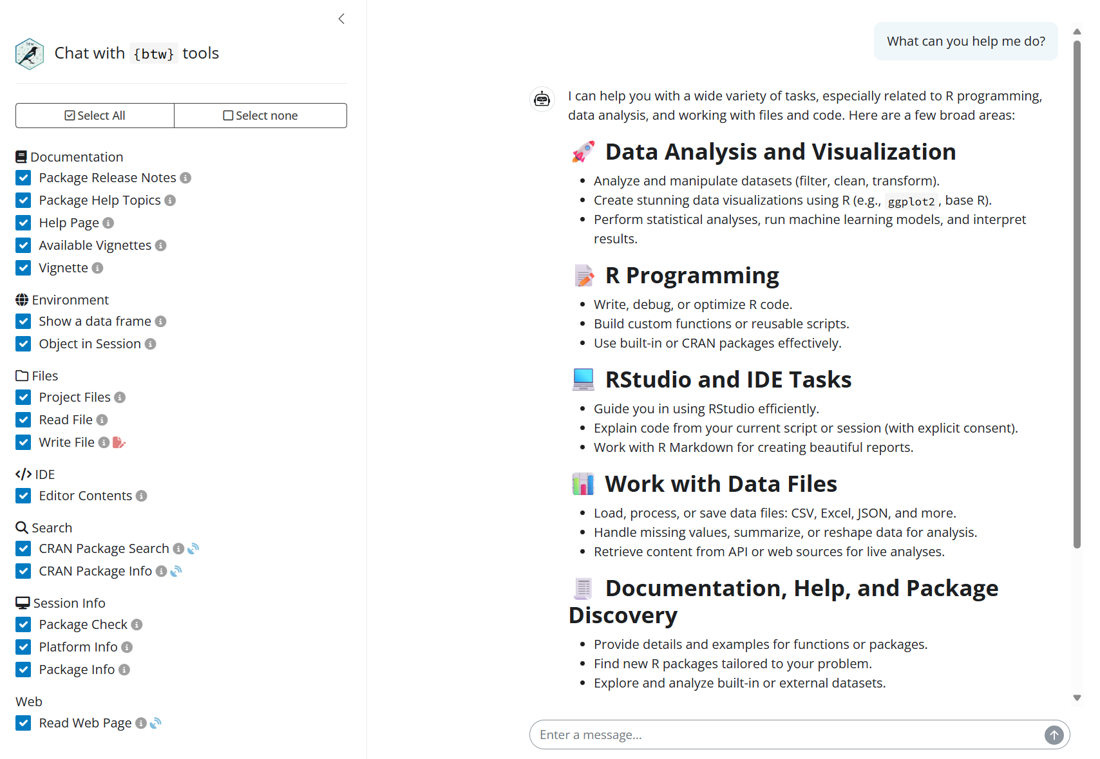
BTW PACKAGE
btw — context collection for LLM
1
Context Collection
Reads R package documentation, data frames, and file contents to provide rich context for LLM.
2
LLM-Ready Output
Formats collected context into structured text that LLMs can understand and reason about.
3
MCP & App Integration
Supports MCP protocol for external agent integration. btw_tools() can be registered with any ellmer chat client for custom Shiny apps.

Slide 10
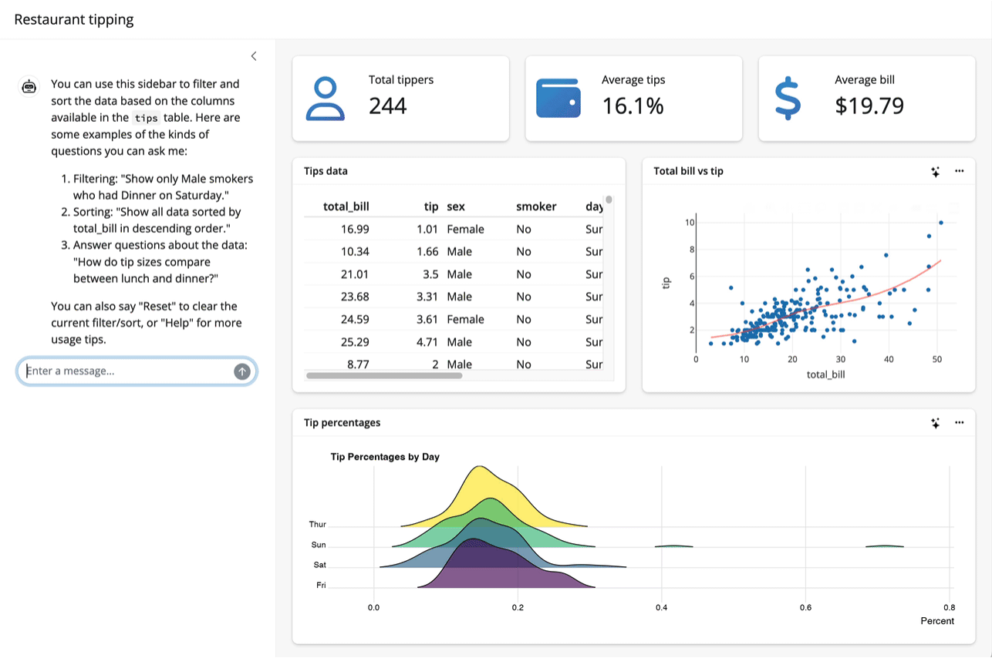
QUERYCHAT
querychat — natural language data query
1
Natural Language Data Query
Enables natural language queries for Shiny apps, generating SQL instead of direct data access for enhanced reliability.
2
LLM Integration
Directly relies on ellmer for LLM backend, supporting GPT-4o, GPT-5.4, and Claude models.
3
Shiny Ecosystem
Compatible with Shiny ecosystem. querychat focuses on data query, shinychat on chat UI.

Slide 11
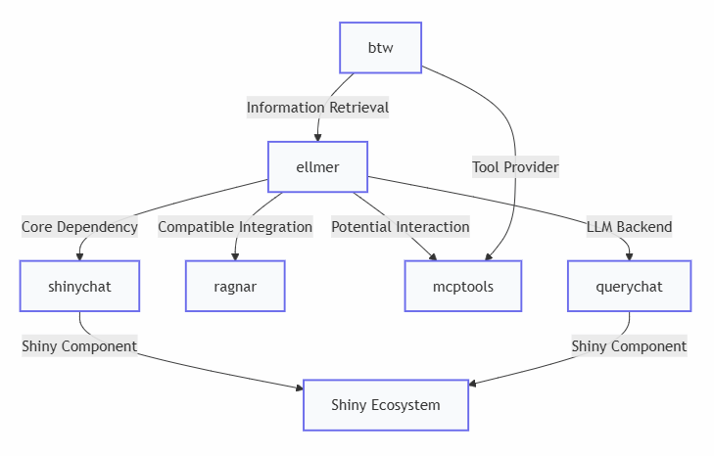
R ECOSYSTEM
R ecosystem & LangChain integration
Package Dependencies
Core R AI Ecosystem
• shinychat → ellmer (direct dependency)
• ragnar → ellmer (compatible)
• mcptools → btw (tool provider)
• querychat → ellmer (LLM backend)
LangChain RAG Pipeline
Python-side CDISC Optimization
• FAISS index: 600+ CDISC templates
• NL query → CDISC-aware rewrite
• reticulate: R ↔ Python bridge
• tool_optimize_query integration
Applications in BIP Copilot
ellmer + shinychat + ragnar pattern
• Interactive data exploration
• CDISC documentation assistance
• RAG-powered query optimization
• Cross-language R + Python pipeline

Slide 12
LANGCHAIN
LangChain & Python RAG integration
Python-side AI pipeline for CDISC-aware query optimization in BIP Copilot
RAG Pipeline
Key Takeaways
FAISS Vector Store
• Prompt Design
Prioritize clarity and explicit constraints to guide model behavior
600+ CDISC templates indexed for similarity search. Biomarker naming conventions, endpoint mappings, and analysis standards.
• RAG Optimization
Optimal chunk size (500-1000 tokens) for best retrieval quality
Query Optimization
LangChain Chain
• Tool Integration
MCP protocol for secure external system connectivity
User's natural language query → retrieve relevant CDISC context → rewrite query with correct terminology and parameters.
• Workflow Management
LangGraph for stateful multi-step processes
R/Python Bridge
• Dual-Language
R statistical power + Python AI flexibility
reticulate Integration
Seamless cross-language call: R's tool_optimize_query invokes Python's biomarker_chain.py via reticulate, zero-copy data transfer.

Slide 13
CORE TOOL
SQL tool — the connective hub
Every analysis starts with data. The SQL tool bridges natural language to the clinical biomarker database.
# Only SELECT allowed — no mutations
if (!grepl("^\\s*select", sql, ignore.case=TRUE))
return(ContentToolResult(error = "Only SELECT"))
# Auto-add LIMIT 100 for safety
sql_final <- paste(sql, "LIMIT 100")
# Execute & format
df <- dbGetQuery(con, sql_final)
gt::gt(df) # beautiful table output
User Question
"Is TMUT_LRP1B prognostic?"
Natural language input
LLM → SQL
SELECT ... FROM results_table
WHERE biomarker = ...
tool_run_sql
Validate, execute, format as gt table
Auto-LIMIT for safety
Results → Viz
Feed into KM / Forest / Box
Tool auto-called with SQL results

Slide 14
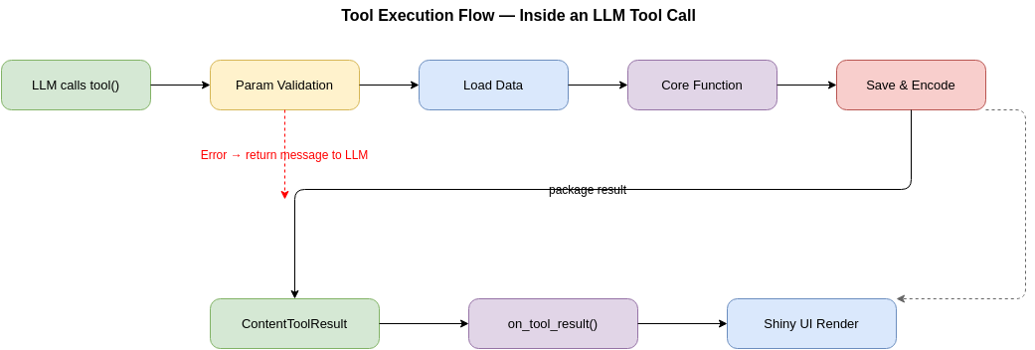
TOOLS
Tool execution flow — inside a tool call
Error at any step → return error message to LLM for user-friendly explanation

Slide 15
TOOLS
Seven clinical biomarker analysis tools
tool_run_sql
SQL Query
DuckDB SELECT, auto-LIMIT, gt table output
tool_optimize_query
RAG Optimizer
LangChain + FAISS for CDISC-aware query rewriting
tool_bip_km_plot
KM Plot
Multi-study survival curves, survminer + patchwork
tool_bip_forestplot
Forest Plot
Subgroup HR visualization with forestploter package
tool_bip_boxplot
Box Plot
Biomarker expression distribution analysis (ggplot2)
tool_bip_get_tableone
Baseline Table
Demographic & baseline characteristics via rtables
tool_generate_report
Report Gen
Independent AI agent → RMarkdown → HTML/PDF/DOCX
NEW

Slide 16
CODE
The ellmer tool use pattern
# Tool definition — ellmer package
tool_bip_km_plot <- tool(
function(version, gene, endpoint) {
# 1. Multi-version support
versions <- unlist(version)
# 2. Load clinical snapshot data
snap <- qread(snap_path)
# 3. Core function (stable layer)
plot <- bip_km_plot(snap, ...)
# 4. Return to LLM + Shiny
ContentToolResult(
value = list(
plot_data = stats,
plot = base64_image
),
extra = list(display = list(
plot = ggplot_obj,
button_id = id
))
)
},
name = "tool_bip_km_plot", ...
)
Two-Layer Design
Core plotting functions stay stable.
Tool layer: validation, data loading,
multi-version, result packaging.
Factory Closures
tool_xxx(con) or tool_xxx(chat, rv)
force() captures in closure scope.
ContentToolResult
value → data for LLM to analyze
extra$display → Shiny UI rendering
Prompt Engineering
type_array() + description emphasis
ensures single-call multi-version.

Slide 17
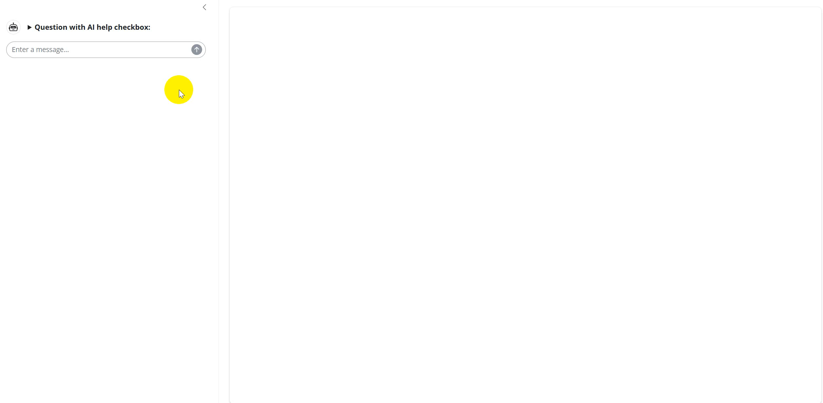
BIP Copilot in Action
LIVE DEMO
▶
Insert video here / Right-click → Insert Media
▶ Watch Demo Video

Slide 18
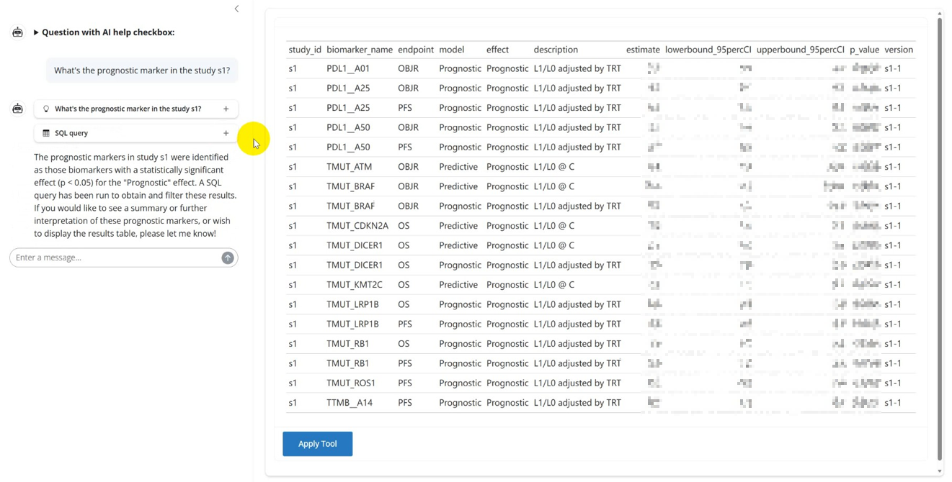
DEMO
SQL query results — structured data output
> "Show all results for PDL1-related biomarkers in s1"

Slide 19
DEMO
Clinical KM survival analysis
> "Is TMUT_LRP1B prognostic in s1 for PFS?"
Multi-study comparison
Dual & single arm curves
Risk table included
Log-rank p-value auto
Confidence interval
AI interpretation

Slide 20
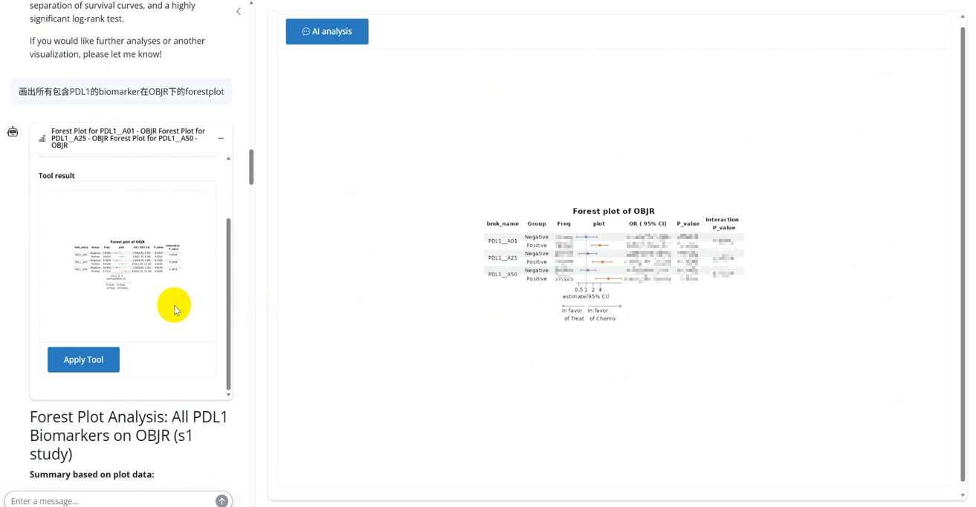
DEMO
Forest plot — subgroup HR analysis
> "Draw forest plots for all PDL1-related biomarkers in OBJR endpoint"

Slide 21
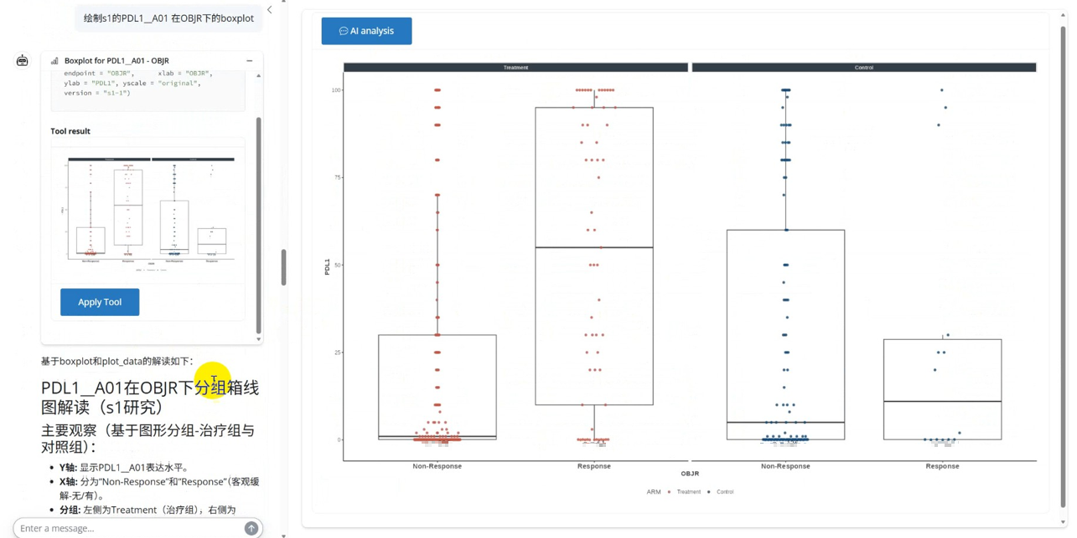
DEMO
Box plot — biomarker expression
> "Draw boxplot for PDL1_A01 in OBJR endpoint"

Slide 22
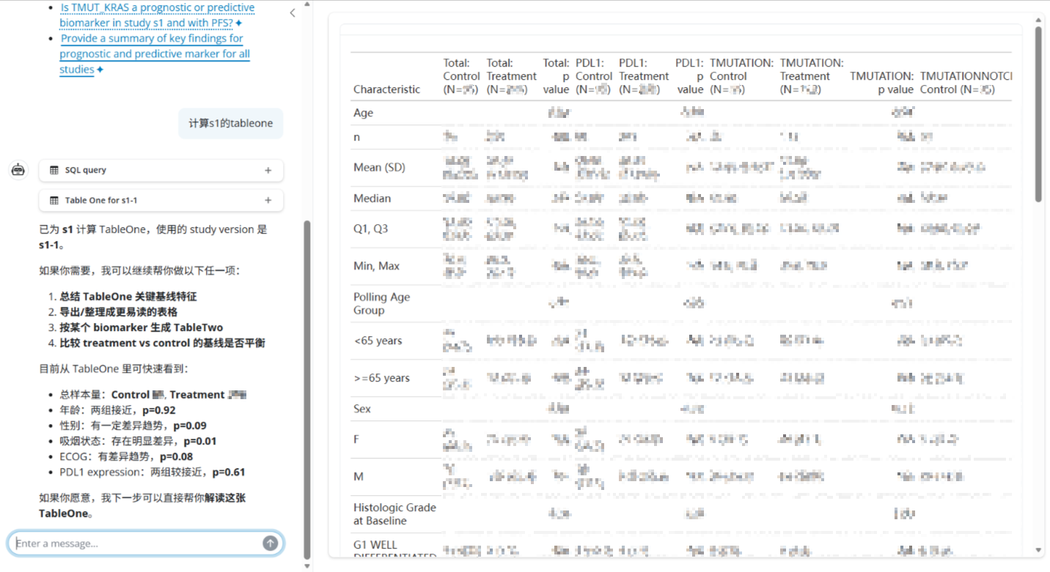
DEMO
Baseline table (TableOne)
> "Calculate TableOne for s1"

Slide 23
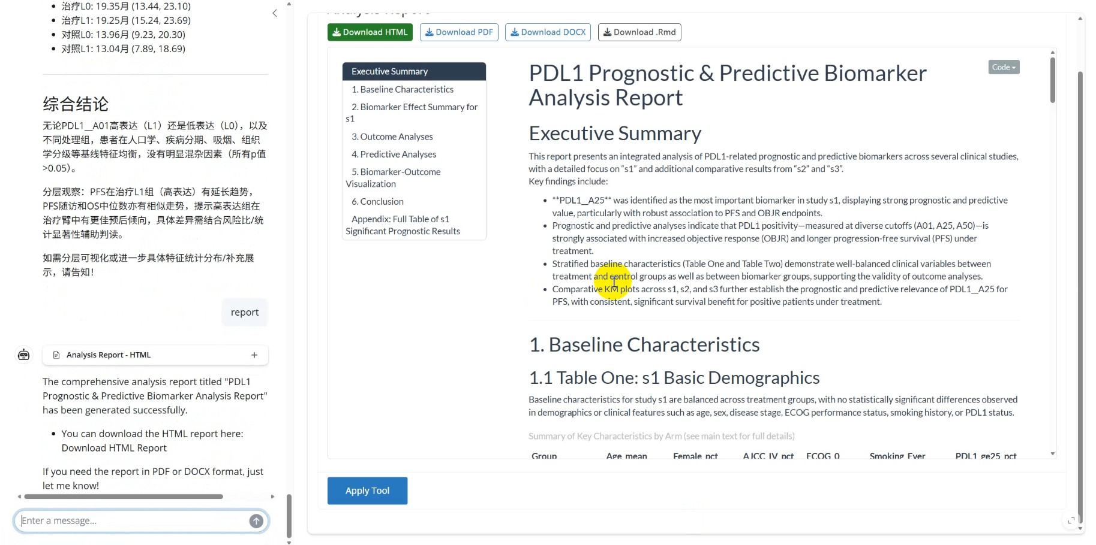
DEMO
AI-generated report output
> "Generate a biomarker analysis report for s1"

Slide 24
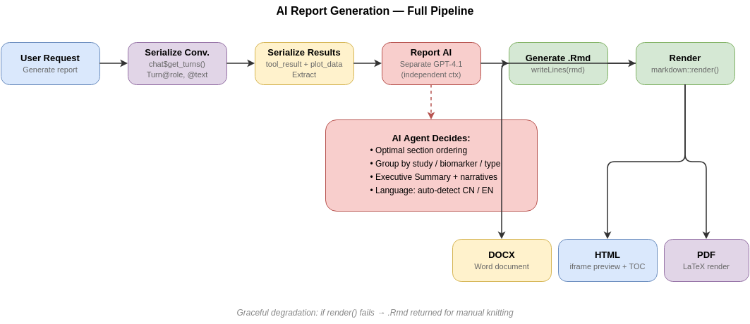
NEW FEATURE
AI report generation — full pipeline
Graceful degradation: if render() fails → .Rmd file still returned for manual knitting

Slide 25
DEVELOPMENT WORKFLOW
Building BIP Copilot
with Claude Code
Anthropic's agentic coding CLI — understands your codebase,
plans before coding, implements autonomously.
Understands
Plans
Implements
Reads entire codebase, package
APIs, R7 class structures,
existing conventions
Designs architecture in plan mode
for user approval before
writing a single line
Creates files, edits multi-file,
runs syntax checks, updates
docs — all autonomously

Slide 26
CLAUDE CODE
From idea to production in one session
Real example: building tool_generate_report.R
1
Describe
User explains requirement
OUTPUT
1 new file
2
Explore
Reads app.R, global.R, ellmer API
tool_generate_report.R
2 files edited
global.R + app.R
1 doc updated
3
Plan
Designs 4 functions, factory pattern
CLAUDE.md
0 bugs
Syntax-checked
4
Implement
Creates tool_generate_report.R (375 lines)
5
Document
Updates CLAUDE.md + global.R + app.R
1 conversation · 3 files · ~400 lines · 0 manual debugging · AI builds the AI tools

Slide 27
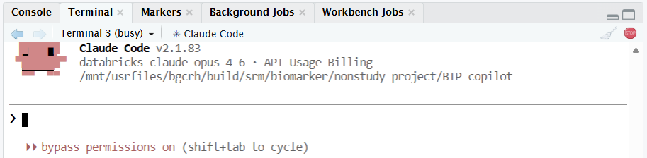
CLAUDE CODE
Claude Code in RStudio
Anthropic's agentic coding CLI running directly in RStudio's Terminal tab
Claude Code v2.1.83
RStudio Integration
Bypass Permissions
Powered by databricks-claude-opus-4-6, running in the BIP Copilot project directory
Runs in RStudio's Terminal tab — read, plan, and implement within the same IDE
Dangerously skip permissions mode for autonomous operation during development

Slide 28
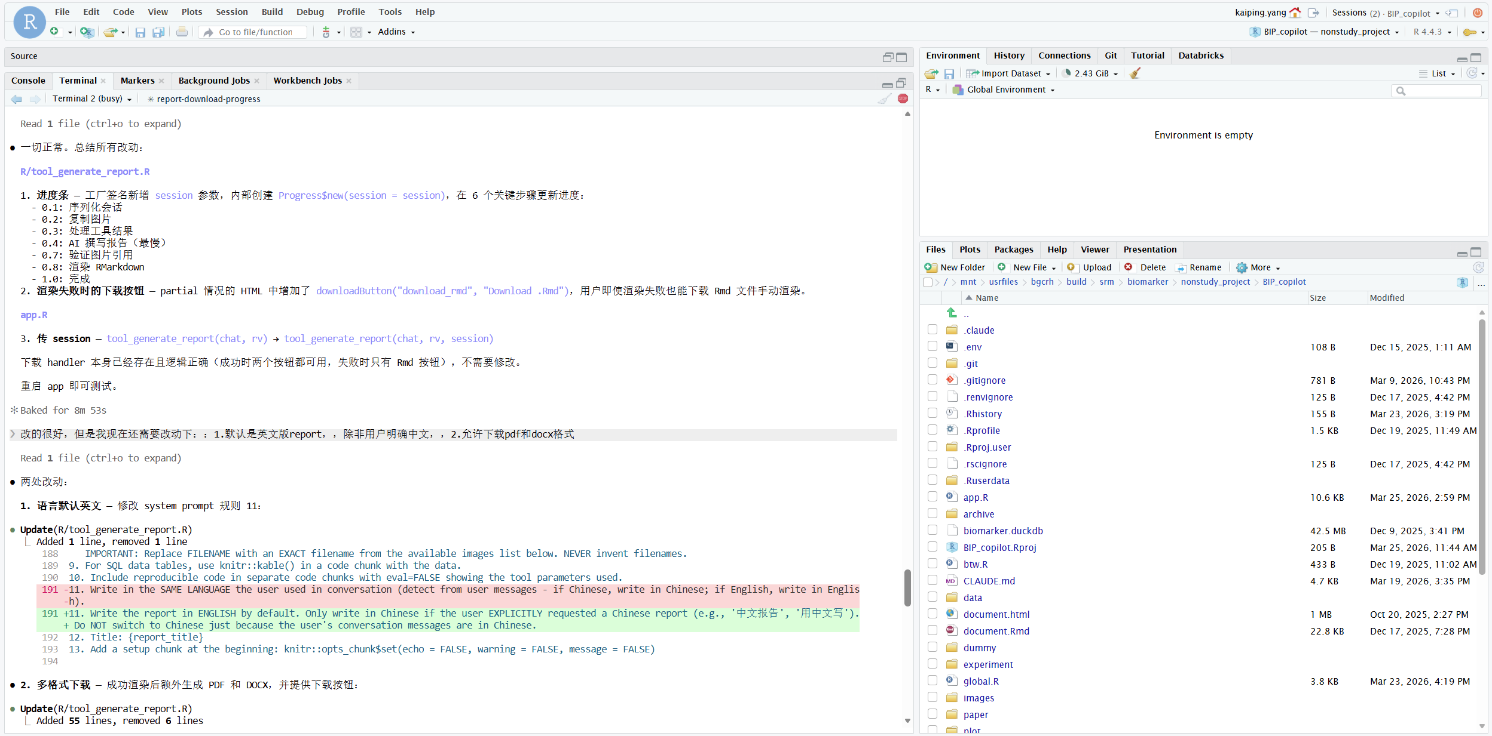
CLAUDE CODE
Real session — building tool_generate_report.R
What happened
Step 1
Claude reads app.R, global.R, and ellmer API docs
Step 2
Designs 4 functions with factory closure pattern
Step 3
Creates 375-line new file: tool_generate_report.R
Step 4
Updates global.R + app.R to wire in the new tool
1 conversation · 0 bugs

Slide 29
FUTURE
Future — from Copilot to Agent
BIP Copilot is the foundation. Claude Agent SDK and multi-agent systems are the next frontier.
Claude Agent SDK Extension
Current: Single-Agent Architecture
Custom agents for specialized clinical workflows
Multi-agent orchestration: data → analysis → report
MCP (Model Context Protocol) for tool interop
Agent-to-agent delegation for complex queries
→
1 LLM + 7 tools via ellmer
tool_generate_report: independent AI instance
Proven pattern for clinical biomarker analysis
Foundation for multi-agent evolution
Roadmap
Short-term
BioMedGPT
More Plots
RWE Pipeline
Domain-specific LLM for biomarker
Waterfall, swimmer, volcano
Real-world evidence support
Long-term
Multi-Language
Federated Learning
Reg. Submission
R / Python / Julia engine
Multi-center collaboration
Automated submission docs

Slide 30
CONCLUSION
Key takeaways
BIP Copilot transforms how R&D teams access biomarker insights — no code needed
CSR scripts → Shiny app → AI Copilot reflects a maturing service model
Pre-computed analysis coexists with flexible real-time AI exploration
Domain expertise encoded in prompts, RAG context, and validated tools
Claude Code accelerates the platform — AI building AI tools for research
Claude Agent SDK: from single-agent Copilot to multi-agent platform
7
3
<30s
0
Clinical
Analysis Tools
Output Formats
Query → Plot
Lines of Code
for End Users

Slide 31
Thank you.
Kaiping Yang · kaiping.yang@beonemed.com
BeOne, Wuhan
R Shiny
ellmer
Claude Code
Clinical AI

